Slide 1
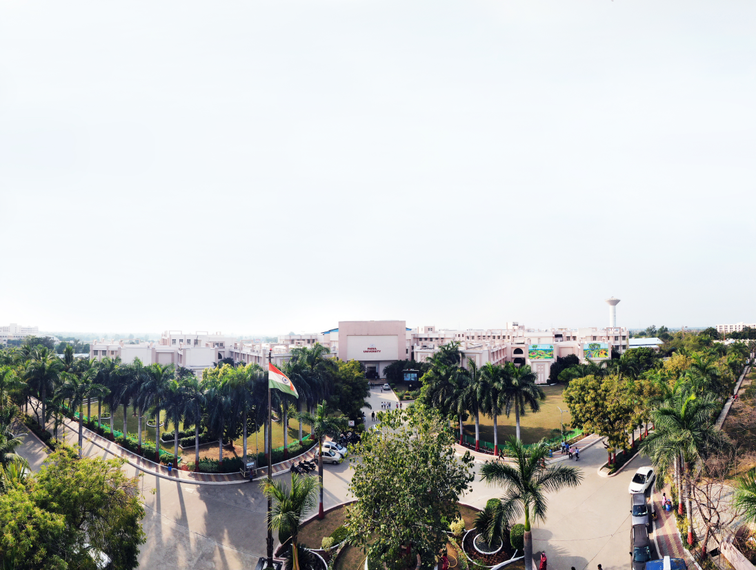


Python Programming Workshop - 1 (Experiments)
Dhruvi Marsonia, Assistant Professor
Computer Science and Engineering, PIT

Slide 2
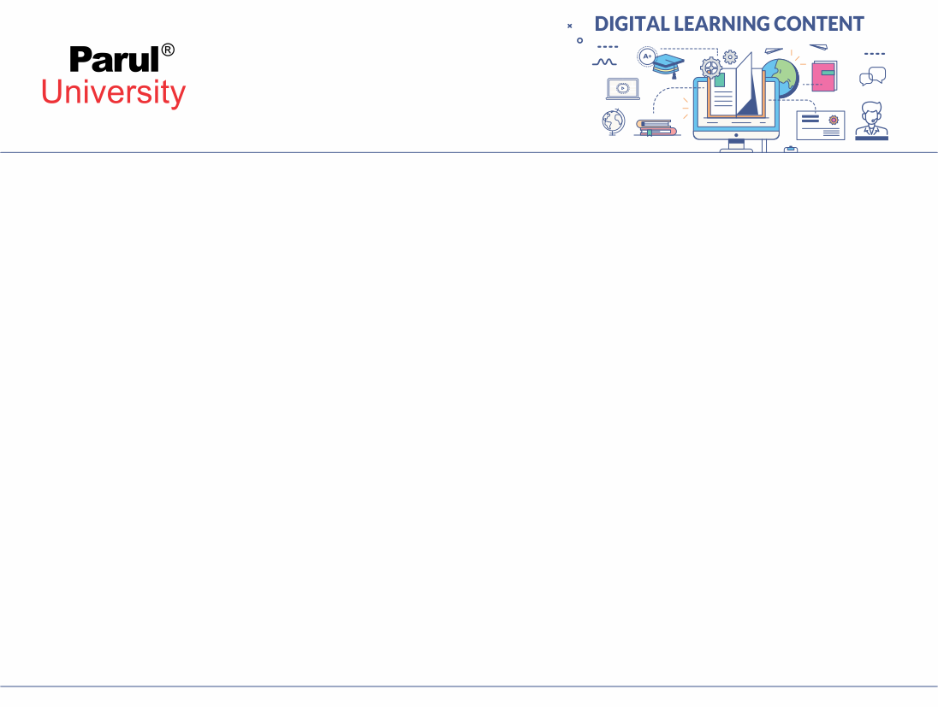

Practical-2
Control Statements in Python

Slide 3
Aim: Control Statements in Python.
Objectives: To Understand Control Statements in Python.
Apparatus/Components: Text Editor or any IDE with python compiler or any Online python compiler with internet

Slide 4
Prerequisites
If-else and if-elif-else
While-loops
For loops
Break, continue, pass, and return.
Pointers in python

Slide 5
Control Statements in Python
Control statements in python are used to control the order of execution of the program based on the values and logic.
Python provides us with 3 types of Control Statements:
Continue
Break
Pass

Slide 6
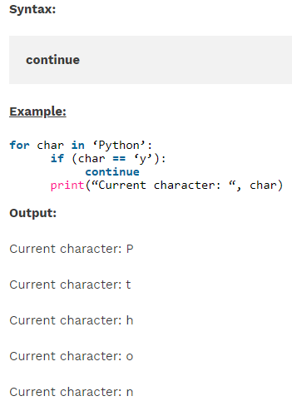
Control Statements in Python
1. Continue Statement:
When the program encounters a continue statement, it will skip the statements which are present after the continue statement inside the loop and proceed with the next iterations.

Slide 7
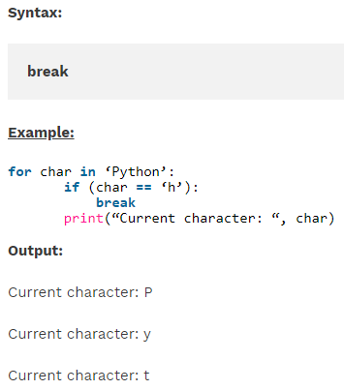
Control Statements in Python
2. Break Statement:
The break statement is used to terminate the loop containing it, the control of the program will come out of that loop.

Slide 8
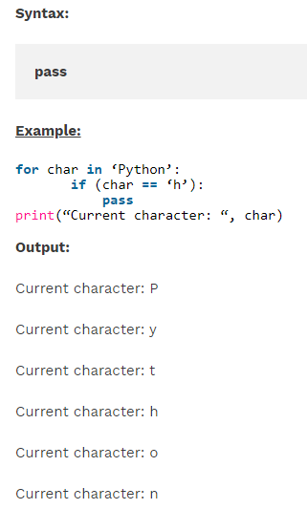
Control Statements in Python
3. Pass Statement:
Pass statement is python is a null operation, which is used when the statement is required syntactically.

Slide 9
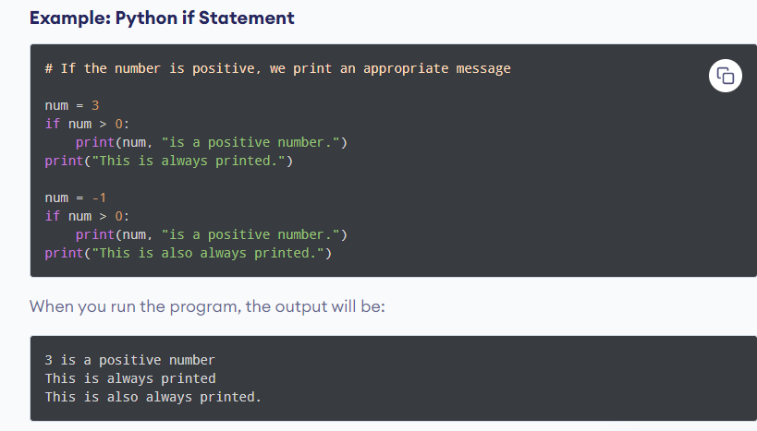
Control Statements in Python
1. if Statement:
An "if statement" is written by using the if keyword.
if test expression:
statement(s)

Slide 10
Control Statements in Python
3. if.. Else Statement:
An "if statement" is written by using the if keyword.
if test expression:
statement(s)

Slide 11
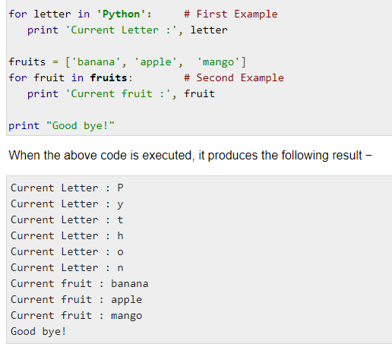
Loops in Python
1. For Loop:
It has the ability to iterate over the items of any sequence, such as a list or a string.
Syntax
for iterating var in sequence:
statements(s)

Slide 12
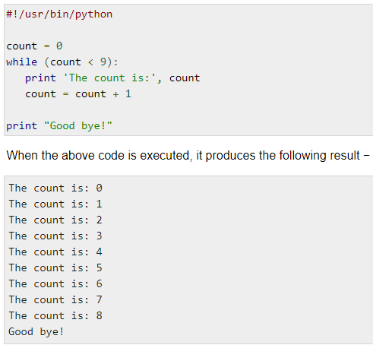
Loops in Python
2. While Loop:
A while loop statement in Python programming language repeatedly executes a target statement as long as a given condition is true.
Syntax
while expression:
statement(s)

Slide 13
Pointers in Python
Pointers:
Pointers are the variables that hold the memory address of another variable. Pointer variables are represented by asterisk (*).
Why Doesn't Python Support Pointers:
The main concept of Python is its simplicity, but pointer violated the Zen of Python. Pointers are mainly encouraged implicit changes rather than explicit ones. They are also complex, especially for beginners.
Pointers tend to create complexity in the code, where Python mainly focuses on usability rather than speed. As a result, Python doesn't support pointer. However, Python gives some benefits of using the pointer.

Slide 14
Pointers in Python
Simulating Pointers in Python:
Python provides alternative ways to use the pointer in Python. These two ways are given below.
Using mutable types as pointers
Using custom Python objects
Immutable objects cannot be modified, where Mutable objects can be modified.

Slide 15
Procedure
Step 1: Open python integrated IDE.
Step 2: import module.
Step 3: Perform basic math operations..
Step 4: Print the result.

Slide 16
Program Demonstration

Slide 17

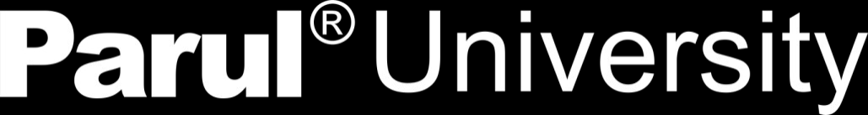

www.paruluniversity.ac.in

